Slide 1
1 Thessalonians 5:12-28
(English Standard Version)
2 Slides

Slide 2
¹² We ask you, brothers, to respect those who labour among you and are over you in the Lord and admonish you, ¹³ and to esteem them very highly in love because of their work. Be at peace among yourselves. ¹⁴ And we urge you, brothers, admonish the idle, encourage the fainthearted, help the weak, be patient with them all. ¹⁵ See that no one repays anyone evil for evil, but always seek to do good to one another and to everyone. ¹⁶ Rejoice always, ¹⁷ pray without ceasing, ¹⁸ give thanks in all circumstances; for this is the will of God in Christ Jesus for you. ¹⁹ Do not quench the Spirit. ²⁰ Do not despise prophecies, ²¹ but test everything; hold fast what is good. ²² Abstain from every form of evil.

Slide 3
²³ Now may the God of peace himself sanctify you completely, and may your whole spirit and soul and body be kept blameless at the coming of our Lord Jesus Christ. ²⁴ He who calls you is faithful; he will surely do it.
²⁵ Brothers, pray for us.
²⁶ Greet all the brothers with a holy kiss.
²⁷ I put you under oath before the Lord to have this letter read to all the brothers.
²⁸ The grace of our Lord Jesus Christ be with you.

Slide 4
Godly Goulash – Everything important, all in together. And don’t forget this.
Not only responsible for ourselves. Encouraging one another. Building one another up.
1. Respecting Godly Leaders
responsibility to lead & sometimes admonish (correct).
2. At peace with one another.
not a place for factions and politics.
3. Not idle.
serving; working; active.
4. Encouraging
Being patient with those who need encouraging in the faith.
5. Forgiving
No place for payback.
6. Rejoice in all circumstances.
Sometimes God’s will for us to suffer.
God is glorified when we praise Him in our suffering.
7. A life of prayer.
Communing with God throughout the day.
8. Do not Quench the Spirit
When God is at work, work with Him.

Slide 5
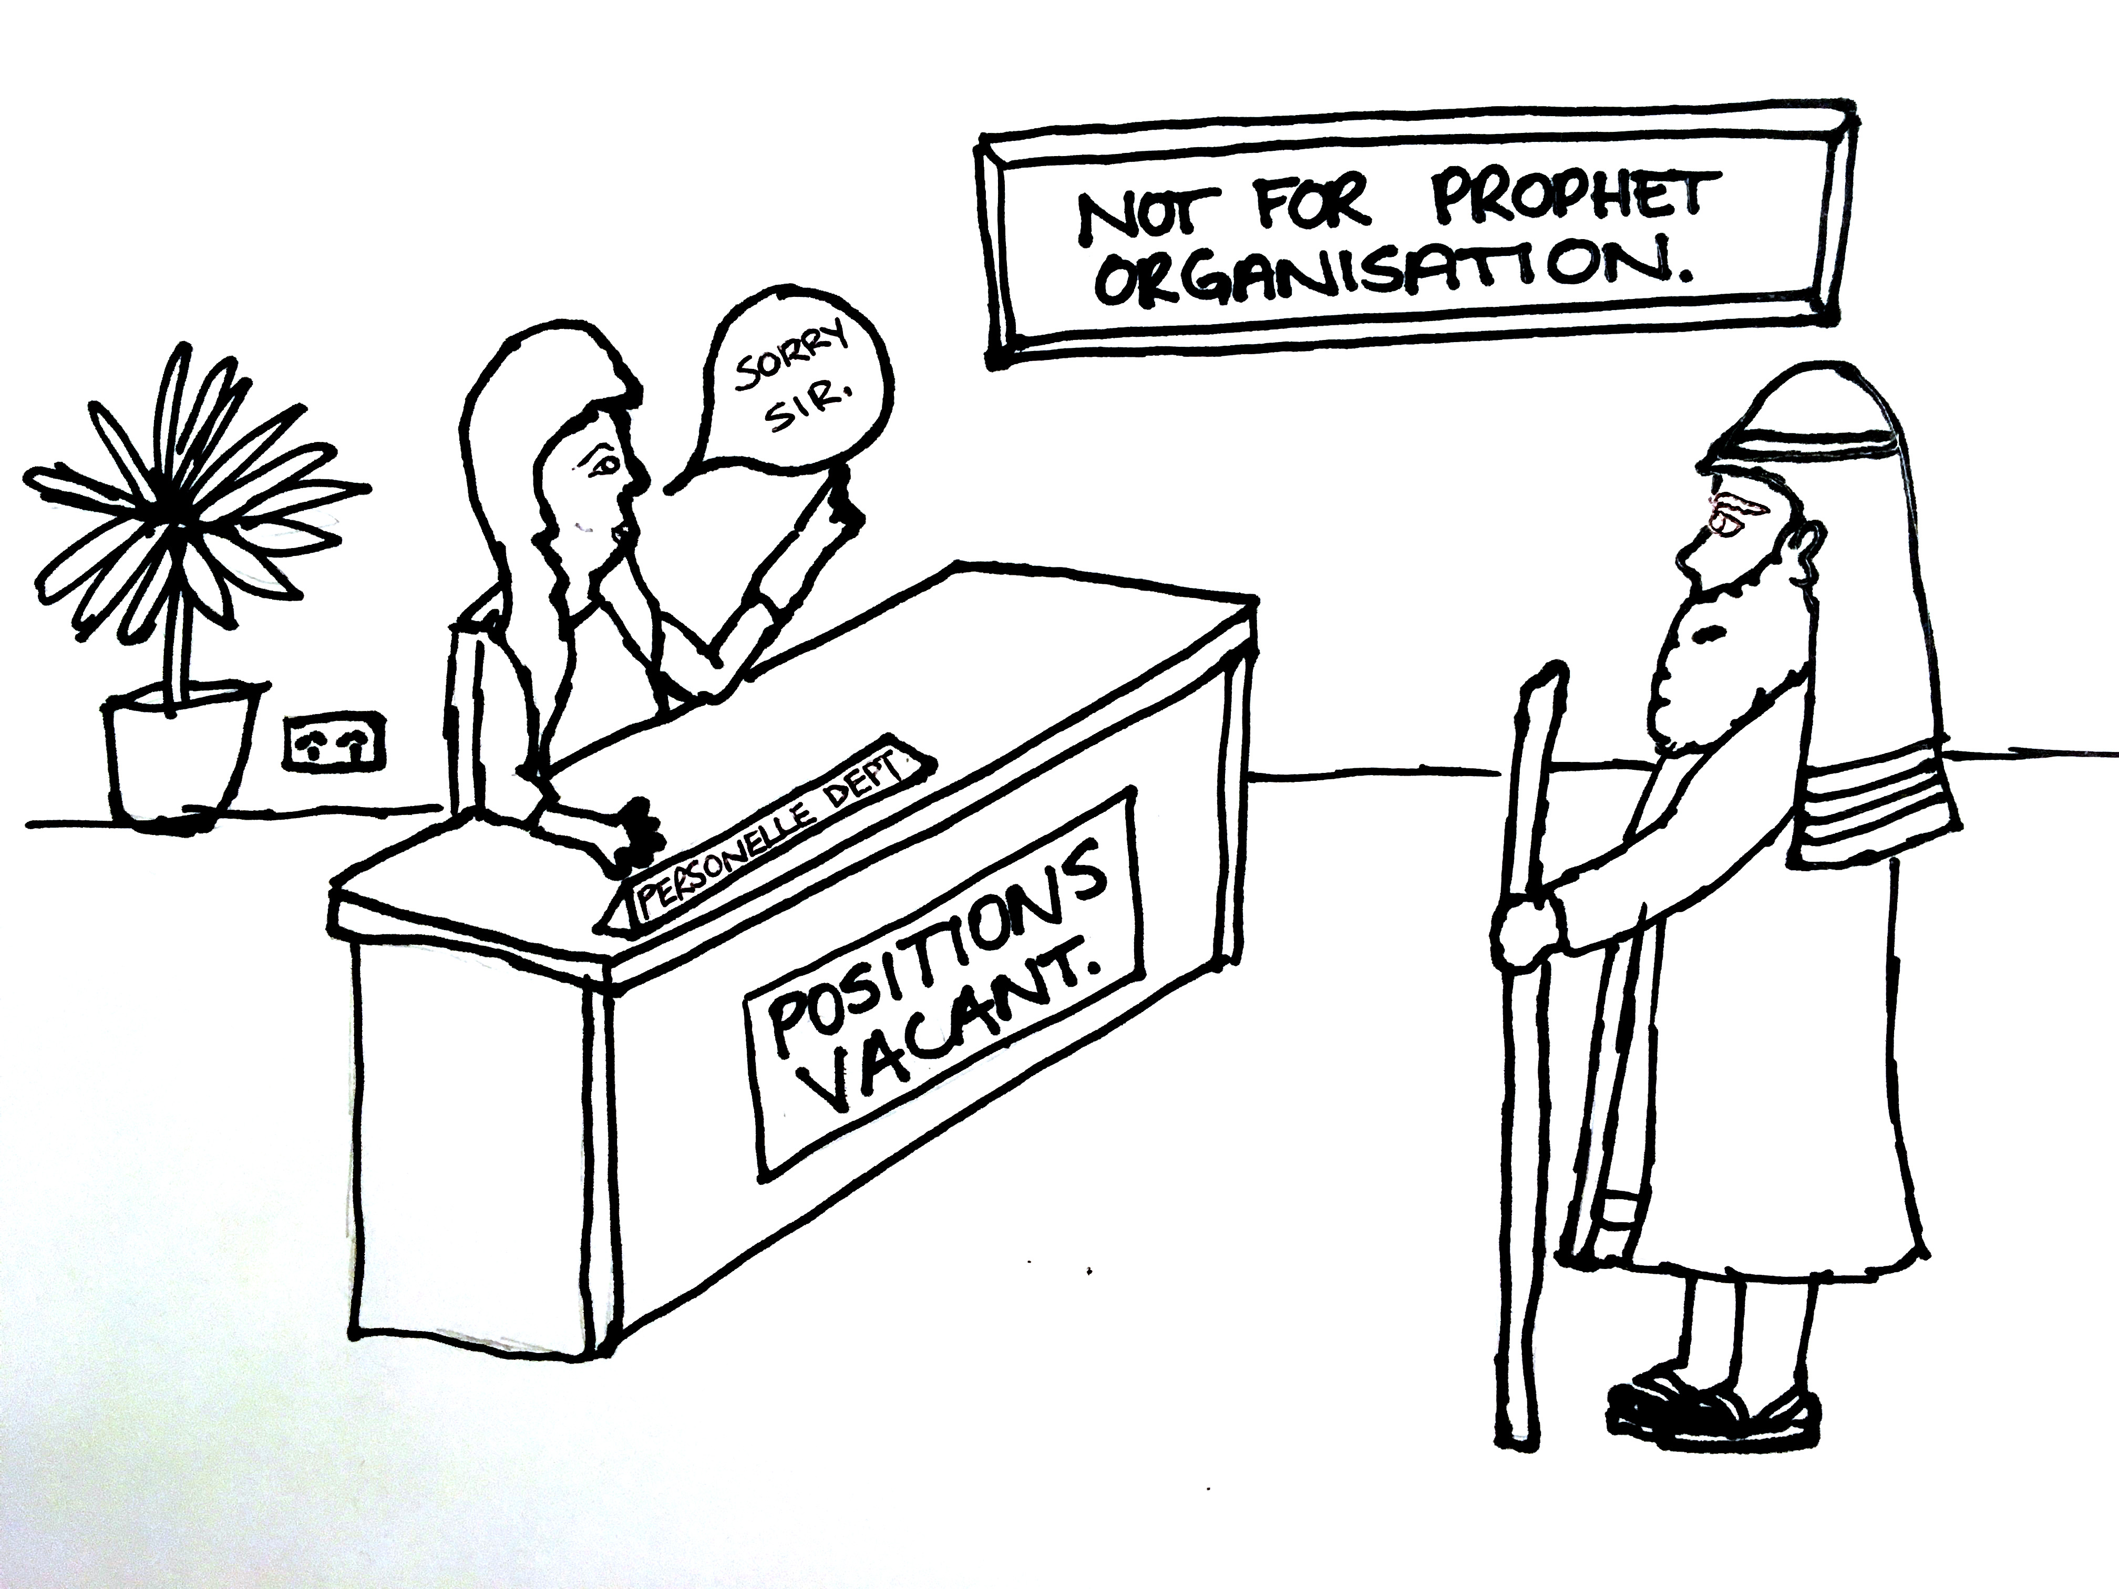

Slide 6
Godly Goulash – Everything important, all in together. And don’t forget this.
Not only responsible for ourselves. Encouraging one another. Building one another up.
1. Respecting Godly Leaders
responsibility to lead & sometimes admonish (correct).
2. At peace with one another.
not a place for factions and politics.
3. Not idle.
serving; working; active.
4. Encouraging
Being patient with those who need encouraging in the faith.
5. Forgiving
No place for payback.
6. Rejoice in all circumstances.
Sometimes God’s will for us to suffer.
God is glorified when we praise Him in our suffering.
7. A life of prayer.
Communing with God throughout the day.
8. Do not Quench the Spirit
When God is at work, work with Him.
9. Discernment
Embracing the one good; Rejecting much evil.
10. Sanctification
We are not up to the level of holiness required.
God Himself makes us holy.
²³ Now may the God of peace himself sanctify you completely, and may your whole spirit and soul and body be kept blameless at the coming of our Lord Jesus Christ. ²⁴ He who calls you is faithful; he will surely do it.

